Slide 1
Database Systems
Lecture 3: ERD (Cont…)
Prof. Dr. Taysir Hassan Abdel Hamid
IS Department,
Faculty of Computers and Information
Assiut University
April 17, 2021

Slide 2
Agenda
More on ERD
Example on Biological Data

Slide 3
Now … Consider the following Example (Employee Database)
The company database keeps track of a company’s employees, departments, and projects.
The company is organized into departments: Each department has a unique number, a unique name, and an employee who manages the department.
A department controls a number of projects, each of which has a unique names, a unique number, and a single location.
We store each employee’s name, social security number, address, salary, gender and birth date.
Keep track of dependents of each employee for insurance purposes.

Slide 4
Minit
Lname
Gender
Address
Fname
Salary
Name
College
Degree
Ssn
Employee
Bdate
An Entity
I.e. An object
With a physical existence
Or a conceptual existence
Part of the ER Model

Slide 5
See Fig. 3.2
Minit
Lname
Gender
Address
Fname
Salary
Name
College
Degree
Ssn
Employee
Bdate
Each Entity has its own attributes that describe its properties
An Attribute
Part of the ER Model

Slide 6
Entity Types, Entity Sets, Attributes, and Keys (Cont.)
Types of Attributes:
Composite versus Simple (Atomic) Attributes
Single-Valued versus Multivalued Attributes
Stored versus Derived Attributes
Null Values
Complex Attributes

Slide 7
Address
Zip
StreetAddress
City
State
Number
Street
Apartment_Number
1. Composite versus Simple Attributes

Slide 8
Minit
Lname
Gender
Address
Fname
Salary
Name
College
Degree
Ssn
Employee
Bdate
Multivalued
One person can have:
No degree
More than 2 degrees
Single-Valued
2. Single-Valued vs Multivalued Attributes

Slide 9
Minit
Lname
Gender
Address
Fname
Salary
Name
College
Degree
Ssn
Employee
Bdate
Value of Age (derived attribute) can be determined
Stored
3. Stored vs Derived Attributes

Slide 10
Minit
Lname
Gender
Address
Fname
Salary
Name
College
Degree
Ssn
Employee
Bdate
Key attribute
Key attribute can be a combination of attribute values

Slide 11
4. Null Values
A particular entity may not have an application value for an attribute.
For example,
Address
StreetAddress
State
Zip
City
Number
Apartment_Number
????
Street

Slide 12
5. A Complex Attribute:
Composite attributes and multivalued attributes can be nested arbitrarily.
Example: AddressPhone
{AddressPhone ( { Phone (AreaCode, PhoneNumber) },
Address (StreetAddress(Number, Street, ApartmentNumber), City, State, Zip) ) }
() A Composite attribute
{ } Displaying multivalued attributes
Example: A person can have more than one residence and each residence can have multiple phones, an attribute AddressPhone for a person.

Slide 13
CAR entity type with two key attributes
State
Number
Vehicleid
Registration
Make
Model
Year
CAR
Color
CAR1
((ABC 123, Cairo), Cairo123, Fiat128, 2003 {white, blue})

Slide 14
Initial Conceptual Design of the COMPANY Database
Department
Name, Number, {Locations}, manager, ManagerStartDate
Project
Name, Number, Location, ControllingDept
Employee
Name(Fname, Minit, Lname), SSN, Gender, Address, Salary
BirthDate, Department, Supervisor, {WorksOn(Project, Hours)}
Dependent
Employee, DependentName, Gender, BirthDate, Relationship
Multivalued
Composite Attribute
Fig. 1

Slide 15
Minit
Lname
Gender
Address
Fname
Salary
Name
Supervisor
Ssn
Employee
Works_on
Bdate
Project
Hours

Slide 16
Gender
Relationship
Employee
Ssn
Dependent
Bdate
Name
Number
Location
Project
Controll_dept

Slide 17
Name
Number
Locations
Manager_sd
Department

Slide 18
Relationship Types, Sets, and Instances
A relationship type R among n entity types E_{1 ,} E₂, …, E_{n} defines a set of associations or a relationship set – among entities from these entity types.
The relationship R is a set of relationship instances r_{i} , where each r_{i} associates n individual entities (e₁, e₂, …, e_{n} ) and each entity e_{j} in r_{i} is a member of entity type E_{j} ,
1 ≤ j ≤ n.

Slide 19
Relationship between Employee and Department
Department
Employee
Works_FOR
r₁
r₂
r₃
d₁
d₂
e₁
e₂
e₃

Slide 20
Degree of a Relationship Type
The degree of a relationship type is the number of participating entity types
Works_FOR
Department
Employee
r₁
r₂
r₃
d₁
d₂
e₁
e₂
e₃
Binary Degree

Slide 21
Supplier
s₁
s₂
s₃
Supply
Project
r₁
r₂
r₃
d₁
d₂
PART
p₁
p₂
p₃
Ternary Degree

Slide 22
Minit
Lname
Gender
Address
Fname
Salary
Name
College
Degree
Ssn
Employee
Bdate
Supervision
Supervisee
Supervisor
2. Recursive Relationships

Slide 23
Relationships as attributes:
Works_FOR
Department
Employee
r₁
r₂
r₃
d₁
d₂
e₁
e₂
e₃

Slide 24
Constraints on Relationship Types
Cardinality ratios for binary relationships: specifies the maximum number of relationship instances that an entity can participate in.
Works_FOR
Employee
Department
r₁
r₂
r₃
e₁
e₂
e₃
d₁
d₂
A 1:N cardinality ratio

Slide 25
Constraints on Relationship Types (Cont.)
MANAGES
Employee
Department
r₁
r₂
r₃
e₁
e₂
e₃
d₁
d₂
d₃
A 1:1 cardinality ratio

Slide 26
Constraints on Relationship Types (Cont.)
WORKS_ON
Employee
Project
r₁
r₂
r₃
e₁
e₂
e₃
p₁
p₂
p₃
A M:N cardinality ratio

Slide 27
Minit
Lname
Gender
Address
Fname
Salary
Name
College
Degree
Ssn
Employee
Bdate
Supervision
Supervisee
Supervisor
N
1
Recursive Relationships

Slide 28
Initial Conceptual Design of the COMPANY Database
Department
Name, Number, {Locations}, manager, ManagerStartDate
Project
Name, Number, Location, ControllingDept
Employee
Name(Fname, Minit, Lname), SSN, Gender, Address, Salary
BirthDate, Department, Supervisor, {WorksOn(Project, Hours)}
Dependent
Employee, DependentName, Gender, BirthDate, Relationship
Fig. 1

Slide 29
Refining the ER Design for the COMPANY Database
Change attributes that represent relationships into relationship types:
MANAGES, a 1:1 relationship type between Employee and Department.
Works_FOR, a 1:N relationship between Employee and Department
CONTROLS, a 1:N relationship type between Department and Project.
SUPERVISION, a 1:N relationship type between Employee and Employee.
Works_ON, a M:N relationship type with attribute Hours.
Dependents_of, a 1:N relationship type between Employee and Dependent.

Slide 30
The numbers mean that for each entity e in E, e must participate in at least min and at most max relationship instances in R at any point in time.
UML will be discussed later in details

Slide 31
Summary of Notations Used
Entity
Weak Entity
Relationship
Identifying relationship
Attribute

Slide 32
Summary of Notations Used (Cont.)
Key Attribute
Multivalued Attribute
Composite Attribute
Derived Attribute

Slide 33
Design Techniques
Avoid redundancy.
Limit the use of weak entity sets.
Don’t use an entity set when an attribute will do.

Slide 34
Avoiding Redundancy
Redundancy = saying the same thing in two (or more) different ways.
Wastes space and (more importantly) encourages inconsistency.
Two representations of the same fact become inconsistent if we change one and forget to change the other.
Recall anomalies due to FD’s.

Slide 35
Example: Good
name
name
addr
ManfBy
Chocolate
Manfs
This design gives the address of each chocolate manufacturer exactly once.

Slide 36
Example: Bad
name
name
addr
ManfBy
Chocolate
Manfs
manf
This design states the manufacturer of a chocolate twice: as an attribute and as a related entity.

Slide 37
Example: Bad
name
manf
manfAddr
Chocolate
This design repeats the manufacturer’s address once for each chocolate and loses the address if there are temporarily no beers for a manufacturer.

Slide 38
Consider a hospital:
Patients are treated in a single ward by the doctors assigned to them. Usually each patient will be assigned a single doctor, but in rare cases they will have two.
Heathcare assistants also attend to the patients, a number of these are associated with each ward.
Initially the system will be concerned solely with drug treatment. Each patient is required to take a variety of drugs a certain number of times per day and for varying lengths of time.

Slide 39
Consider a hospital: (Cont…)
The system must record details concerning patient treatment and staff payment. Some staff are paid part time and doctors and care assistants work varying amounts of overtime at varying rates (subject to grade).
The system will also need to track what treatments are required for which patients and when and it should be capable of calculating the cost of treatment per week for each patient (though it is currently unclear to what use this information will be put).

Slide 40
How do we start an ERD?
Define Entities: these are usually nouns used in descriptions of the system, in the discussion of business rules, or in documentation;
2. Define Relationships: these are usually verbs used in descriptions of the system or in discussion of the business rules
3. Add attributes to the relations; these are determined by the queries,and may also suggest new entities, e.g. grade; or they may suggest the need for keys or identifiers.

Slide 41
What questions can we ask?
a. Which doctors work in which wards?
b. How much will be spent in a ward in a given week?
c. How much will a patient cost to treat?
d. How much does a doctor cost per week?
e. Which assistants can a patient expect to see?
f. Which drugs are being used?

Slide 42
4. Add cardinality to the relations
Many-to-Many must be resolved to two one-to-manys with an additional entity
Usually automatically happens
Sometimes involves introduction of a link entity (which will be all foreign key) Examples: Patient-Drug

Slide 43
5. This flexibility allows us to consider a variety of questions such as:
a. Which beds are free?
b. Which assistants work for Dr. X?
c. What is the least expensive prescription?
d. How many doctors are there in the hospital?
e. Which patients are family related?

Slide 44
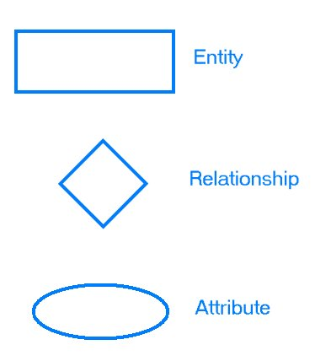
6. Represent that information with symbols. Generally E-R Diagrams require the use of the following symbols:

Slide 45
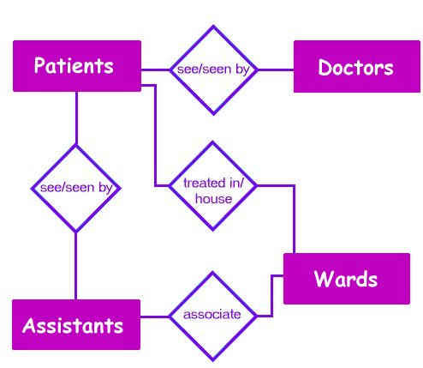

Slide 46
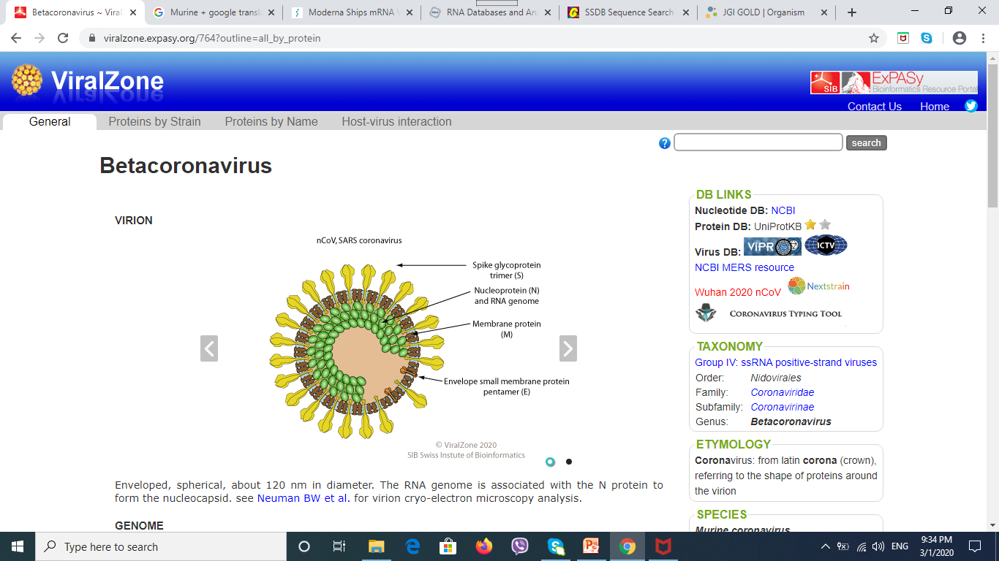
Example : Corona Virus
From https://viralzone.expasy.org/764?outline=all_by_protein Enveloped, spherical, about 120 nm in diameter. The RNA genome is associated with the N protein to form the nucleocapsid. see Neuman BW et al. for virion cryo-electron microscopy analysis.

Slide 47
Betacoronavirus
Betacoronavirus
Human
Bat coronavirus
HKU3 (BtCoV)
Murine coronavirus)
(strain JHM) (MHV-JHM)
(strain A59) (MHV-A59
(BtCoV)
SARS coronavirus (SARS-CoV)
OC43 (HCoV-OC43)

Slide 48
Betacorona virus contains a number of strains
Each Organism (strain ) contains a set proteins (Matching UniProtKB/Swiss-Prot entries)
A protein has a unique UniProtKB identifier (accession number ) , similar proteins, sequence, protein name, gene name, domain, family, structure.

Slide 49
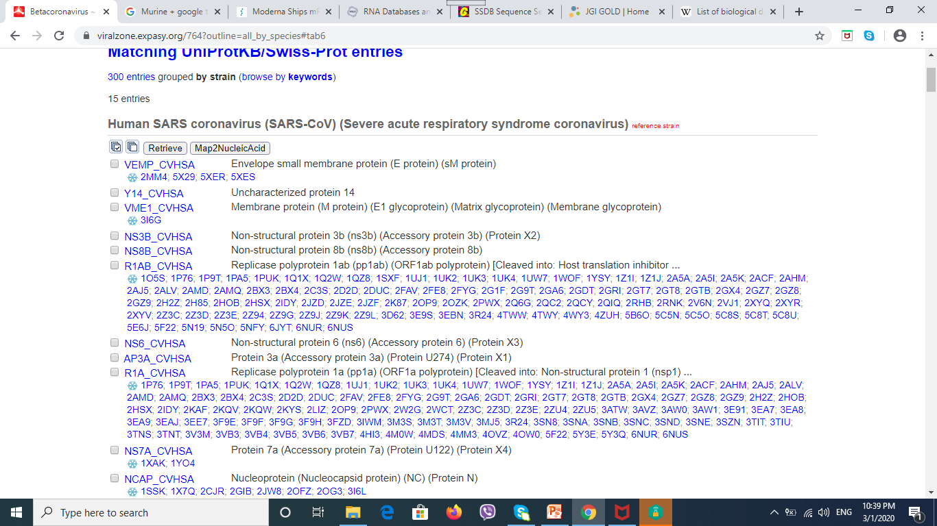

Slide 50
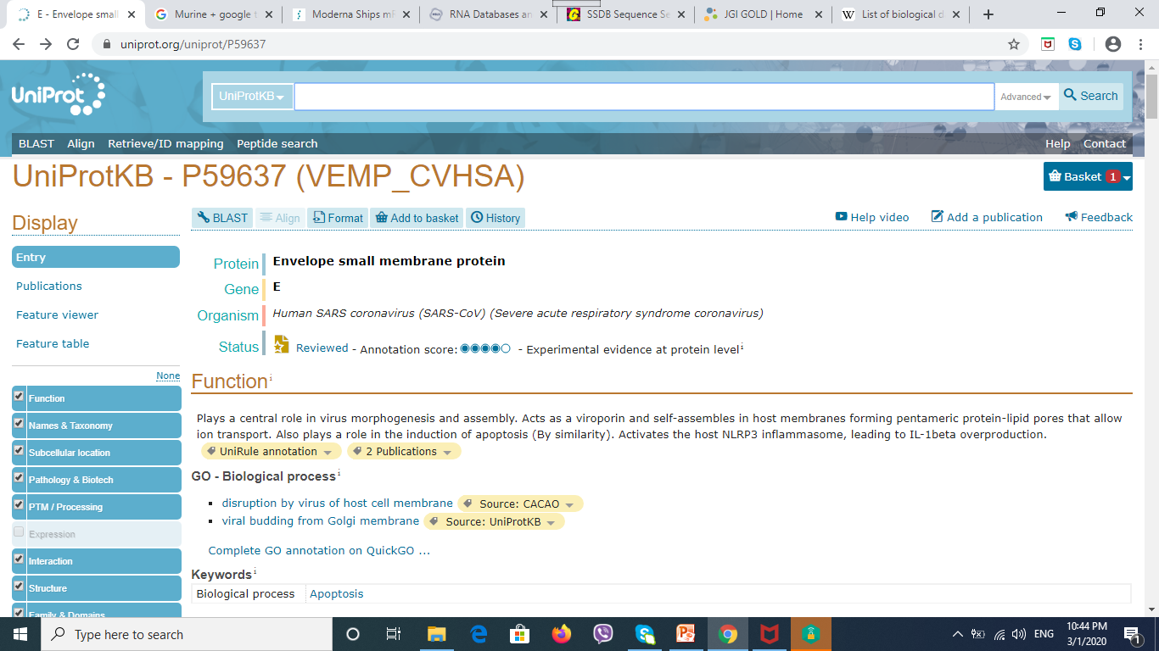

Slide 51
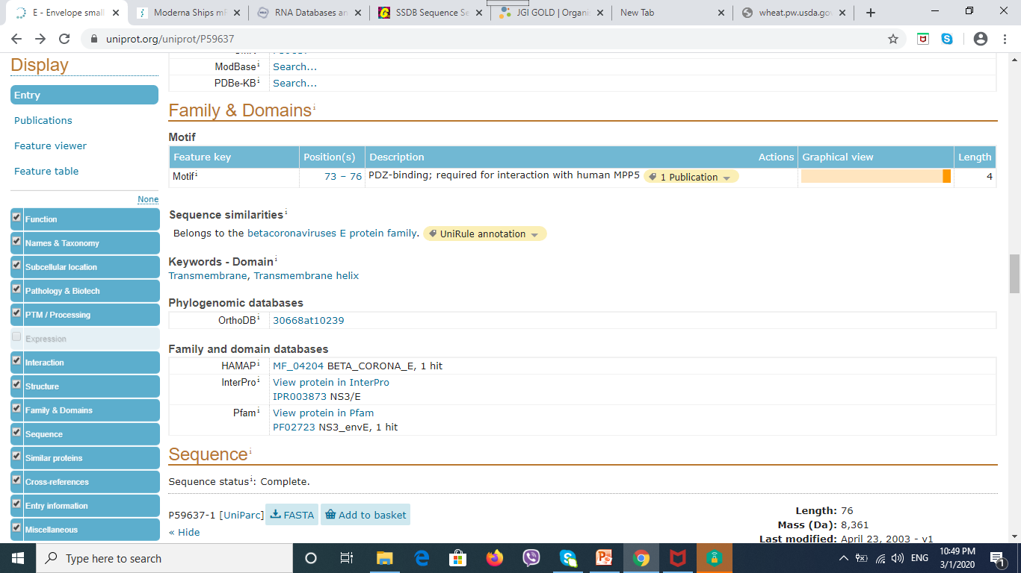

Slide 52
End of Today’s Lecture

